Slide 1
A Guide to Ethical Hackers
Luke Sprecher and Gavin Waibel

Slide 2


Tasks/Responsibilities of an Ethical Hacker:
Simulate cyberattacks and exploit vulnerabilities in a system
Suggest ways to improve security
Report any findings to the contractor

Slide 3

Required Education and Skills
Required Education:
A CEH (Certified Ethical Hacker) or other related certifications is the minimum
Bachelor's Degree is recommended, but not required
Needed Hard / Soft Skills:
Strong understanding of networking, OS, programming, and penetration tools
Communication, problem solving, critical thinking, and efficiency

Slide 4

Salary
Entry Level Salary | Mid-Career Salary | Senior-Level Salary
$39,000 - $78,000 | $90,000 - $130,000 | $120,000 - $176,000
Luke Sprecher & Gavin Waibel

Slide 5


Job Outlook
The job outlook for Ethical Hackers is high.
The growth rate for the next ten years:

Slide 6

Connection to SEWD
Skills Related to Our Program:
Programming is pivotal for hacking
You need to have the ability to rework/reverse engineer software and code
Knowledge on SQL Databases and servers are critical
Advanced computer knowledge is necessary too

Slide 7
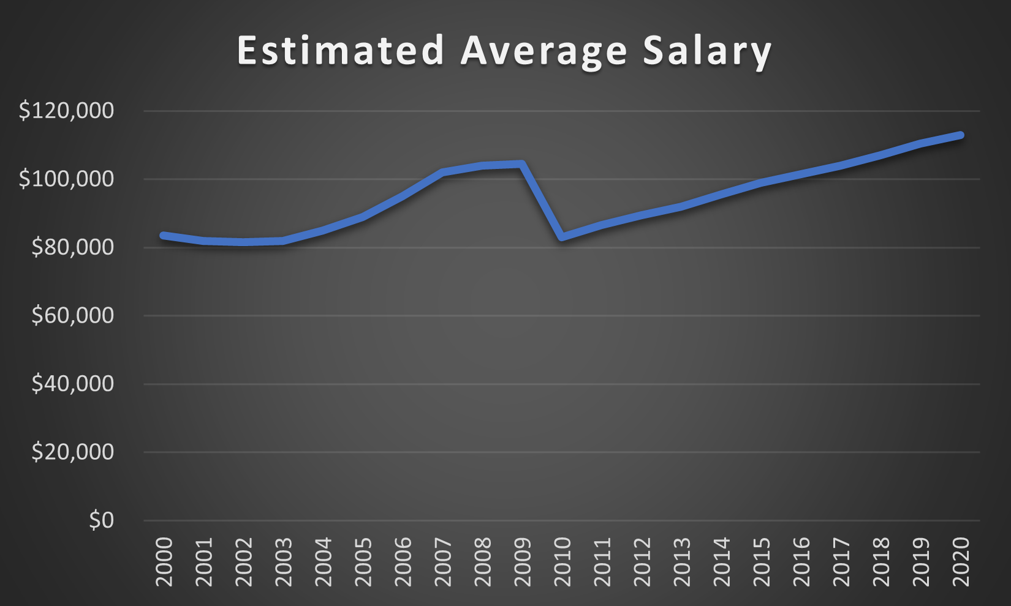
Salary Trend from 2000-2020

Slide 8

Sources
Bureau of Labor Statistics (BLS):
https://www.bls.gov/careeroutlook/2018/interview/cybersecurity-consultant.htm
Indeed.com:
https://www.indeed.com/career-advice/finding-a-job/how-to-become-ethical-hacker
Career One Stop:
https://www.careeronestop.org/Toolkit/Training/find-certifications.aspx

